Slide 1


A web-based platform tackling the big accessibility question surrounding mental health
Notes:
Serenity, A web-based platform tackling the big accessibility question surrounding mental health

Slide 2

“A strategic and preventive approach to deliver mental well-being and total health to our people.”
—Anthea Ong
Nominated member of Parliament
Notes:
Mental healthcare in Singapore has long been stigmatized by society. Earlier this year, nominated member of parliament, Anthea Ong, sought a change in this status quo and called for bold steps towards building a more inclusive and encompassing community.

Slide 3

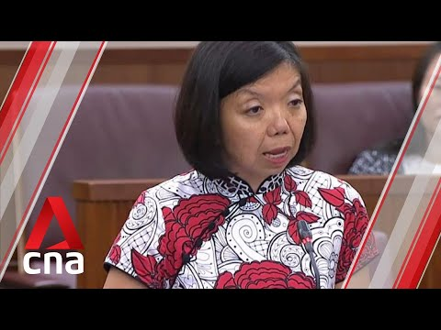
Mental Health in Singapore
Notes:
Her extensive surveys and research on Singapore’s mental healthcare landscape has identified accessibility, affordability, and quality issues surrounding the mental health community

Slide 4

38.2%
Indicated facing issues with mental health accessibility
01
02
03
Distribution
Supply
Diversification
SG MENTAL HEALTH MATTERS Budget 2020 Survey
lack of clear trusted and consolidated information
Long wait and referral issue when seeking medical attention
Alternative means of communication outside helplines
Notes:
Our team narrowed down on the biggest issue raised, accessibility, which 38.2% of survey respondents indicated facing difficulties with. We categorised their concerns into three main groups - Distribution of information, the Supply of medical needs, and the Diversification of communication options

Slide 5
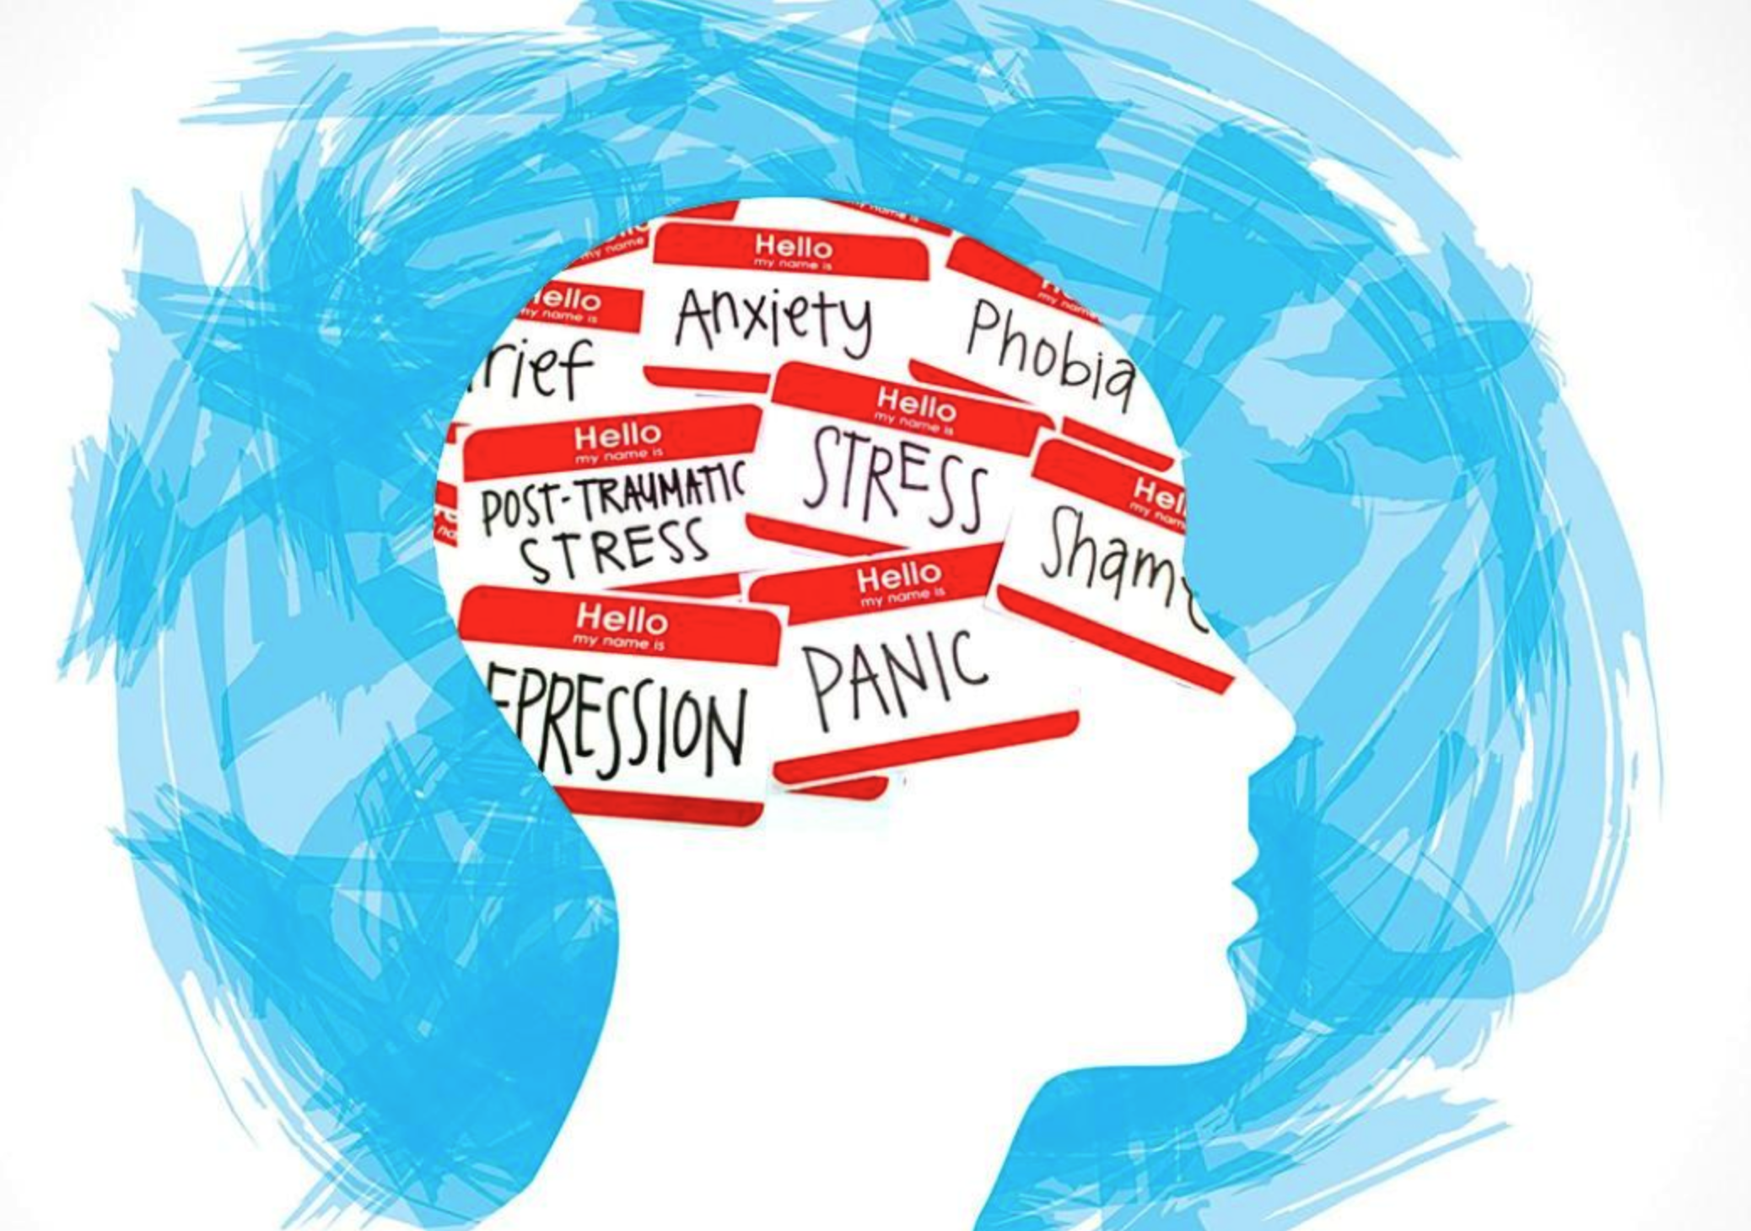
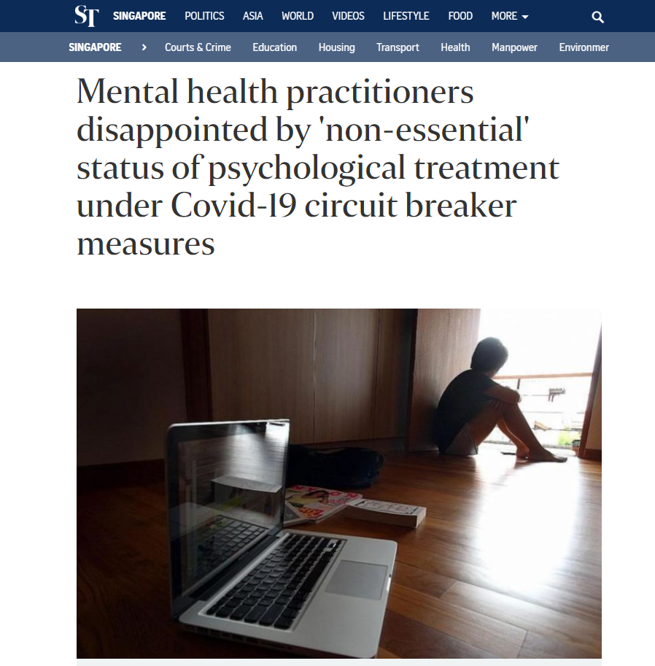
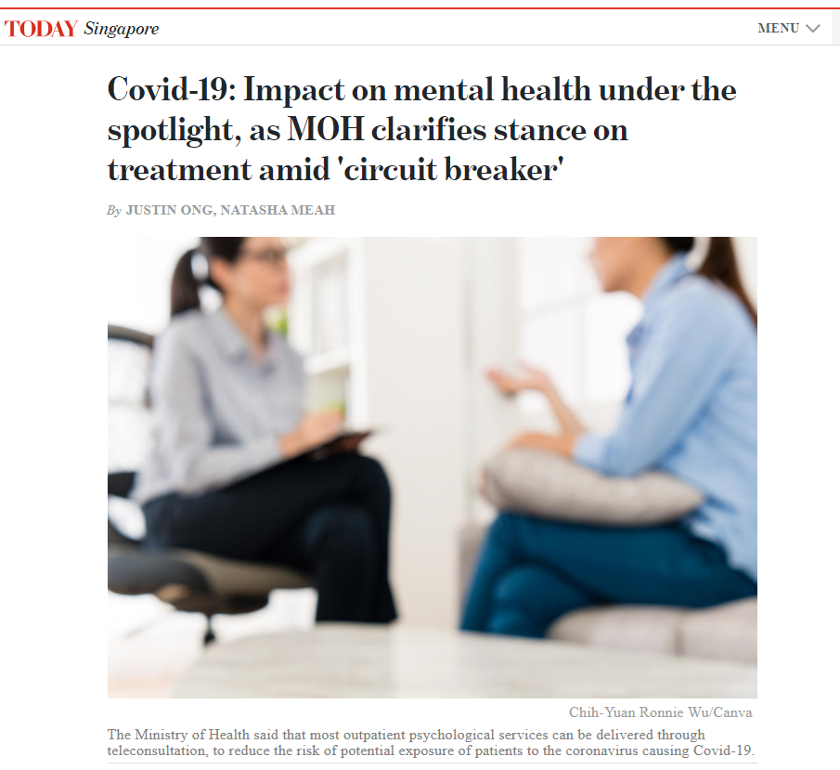
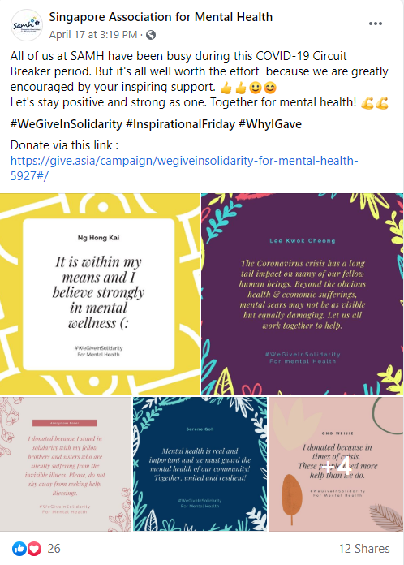
COVID-19
Notes:
Additionally, with the COVID-19 situation slated to last at least another year in some reports, we believe it is prudent to implement more intervention measures, given mental health’s impact various facets of life. Many also feel that this is one key area that has fallen through the cracks in the government’s COVID-19 relief efforts.
ADDED ANIMATION
1st image (left back)
Disappointment that “Mental Health” was considered “non essential” in Singapore when it has been prominent in the past few years, namely having more work place burnouts and an obvious lack of work-life balance. With this Work-From-Home scheme, are employees be working 24/7? Do they need help, or even a shoulder to cry on?
2nd image (right back)
People have gone online to show their appreciation and encourage others in this difficult times. Social Media has been more welcoming in terms of accepting mental health as everyone are more understanding in this pandemic.
3rd image (middle front)
MOH mentioned that psychological services teleconsultation can be done for outpatients. But what about individuals who are new or need help especially in this period?

Slide 6
Serenity’s Centralised Platform
Distribution
Supply
Diversification
Directory to help individuals identify an appropriate provider for mental health support
Platform for mental health counselors to speak to patients
(voice chat, video call or text chat)
Avenue for individuals to seek urgent mental help
(voice chat, video call or text chat)

Slide 7
OUR UI
Notes:
1.5 mins to go through our UI.\
Moving on to our website, serenity. (Similar to the earlier 3 goals, we have set aside 3 functionalities to tackle those goals)

Slide 8

Communicating to mental health counselors
Dedicated platform for mental health professionals for consultations via video call.
View appointments between professionals and patients.
Usable as a substitute to live patient visits during COVID-19
Notes:
To tackle the problem of supply:
Our app serves as a platform for us to communicate mental health counselors directly, from the comfort of their home. Once a user books an appointment with a mental health professional, they are able to contact them using video call/ voice or chat for a live consultation, eliminating the anxiety one experiences from long queues, and is especially useful during the circuit breaker.

Slide 9
Directory for mental health services
Simple Questionnaire to direct individuals to relevant mental health hotlines for their specific needs.
Allows individuals to contact (or book appointments) participating hotlines using our online call service.
Notes:
For distribution, individuals can finish a simple questionnaire regarding the issue that they are facing. From there, the page will redirect them to a list of relevant healthcare providers. Furthermore, it gives the option for the individual to call the hotline, or for certain providers, do a video call using our platform.

Slide 10
Urgent Mental Help
One click option for a distressed individual to talk to someone.
Connects to SOS (Samaritans of Singapore)
Maintains anonymity
Notes:
Lastly, we have an option for individuals that require urgent mental help.They can click the button to speak to a volunteer from SOS anonymously using our platform.

Slide 11
Scalability
Expand language options
Expand to other allied health Services
Expand to include peer support platforms
Integration with existing government database
Integration with existing government call helpline
Notes:
health service probably means professionals in the mental health care scene (puts psychologist practitioner graduates in the economy for once. Ouch)
Peer support are probably just like talking to anon people who just love talking to people and helping them out. Volunteers I guess
as for the govt DB, its just seeing the potential for our database to contain more helplines that we have in Singapore?
Existing government call line probably points to our “talk now” function where we can directly go to the Samaritan line instead of going to idk where now HAHHAHA
and like, probably connect to their hotline once you press on the button instead of just showing them the number
This is what I interpret it as, not sure if its accurate
(Belle)

Slide 12
Credits
This is where you give credit to the ones who are part of this project.
Presentation template by Slidesgo
Icons by Flaticon
Infographics by Freepik
Images created Freepik and Founder Institute
Author introduction slide photo created by Freepik
Text & Image slide photo created by Freepik.com

